Slide 1

Prototype Global Sustainable Development Report
DESA-UNESCO-UNIDO side event for HLPF, New York, 1 July 2014
R. Alexander Roehrl, DESA/DSD

Slide 2

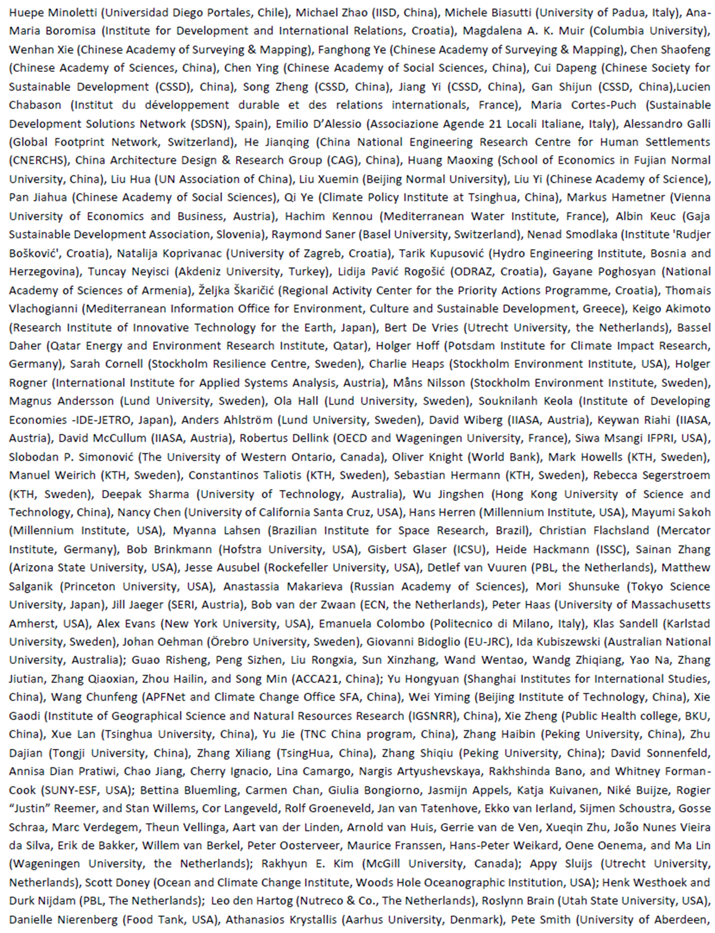
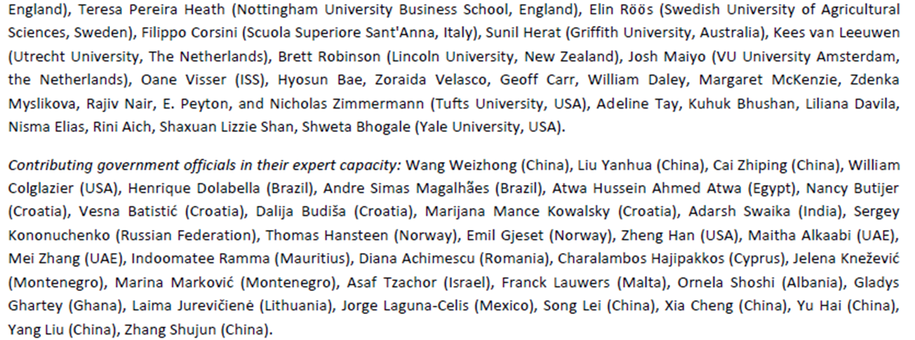
Prototype Global Sustainable Development Report
Contributors

Slide 3
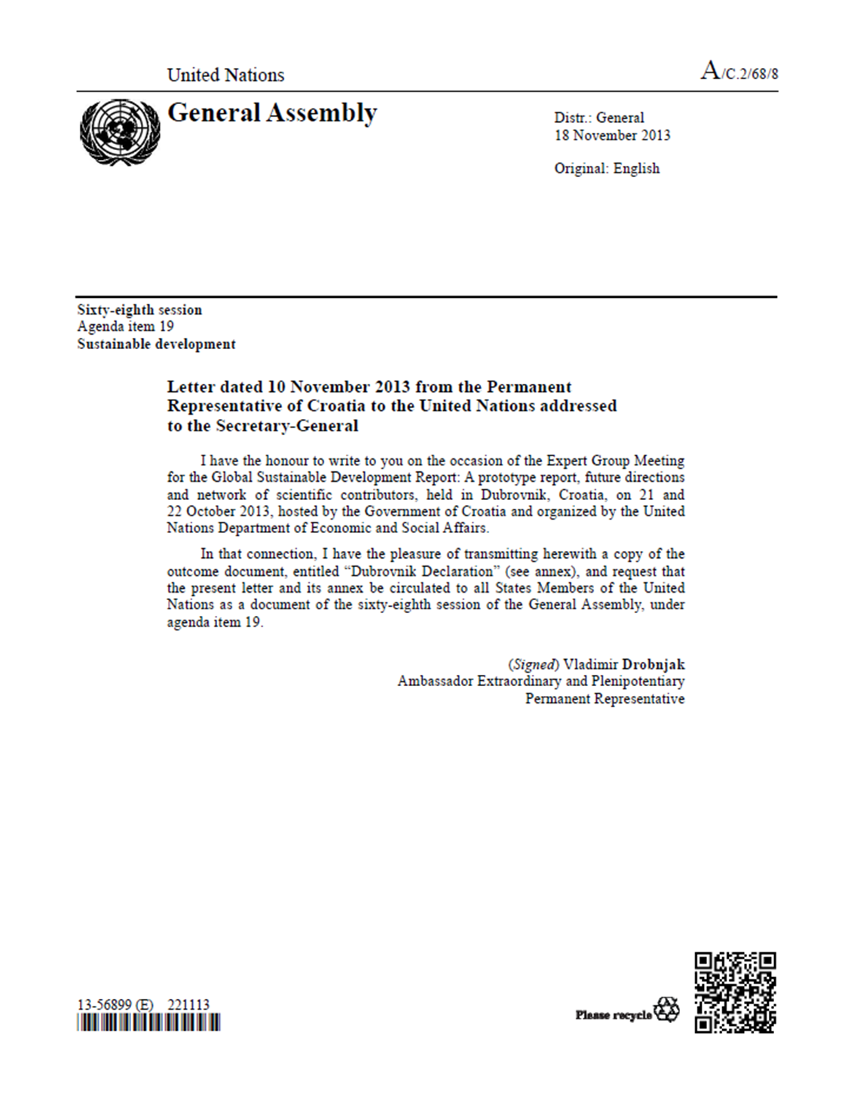

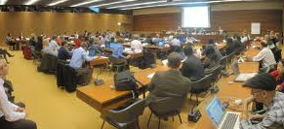
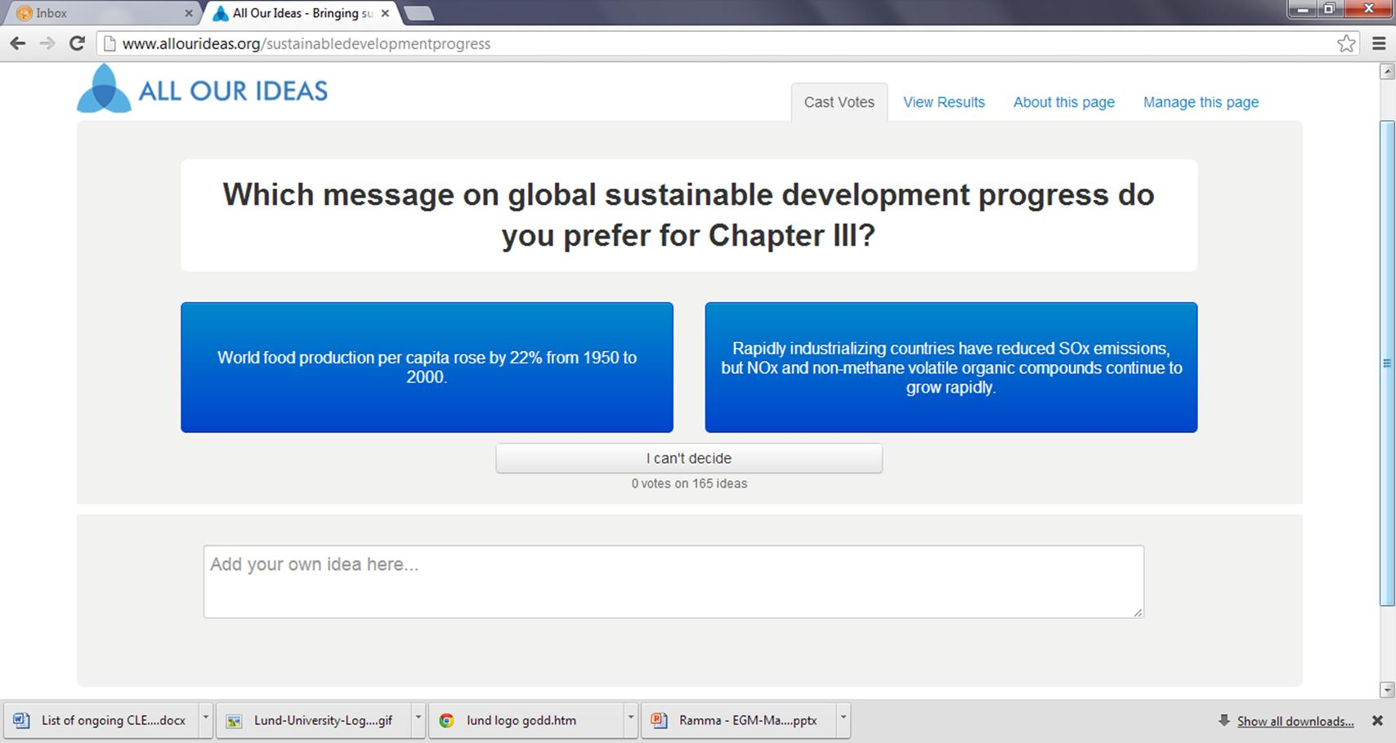
Mixed multi-stakeholder approach for inputs

Slide 4







(2) Landscape of Assessments
    Lessons for future reports:
    → thousands of assessments; many perspectives;
    multiple knowledge channels; bottom-up from national

Slide 5
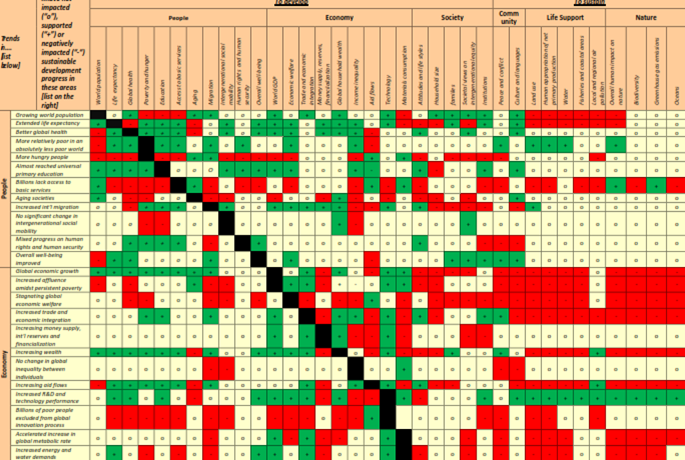
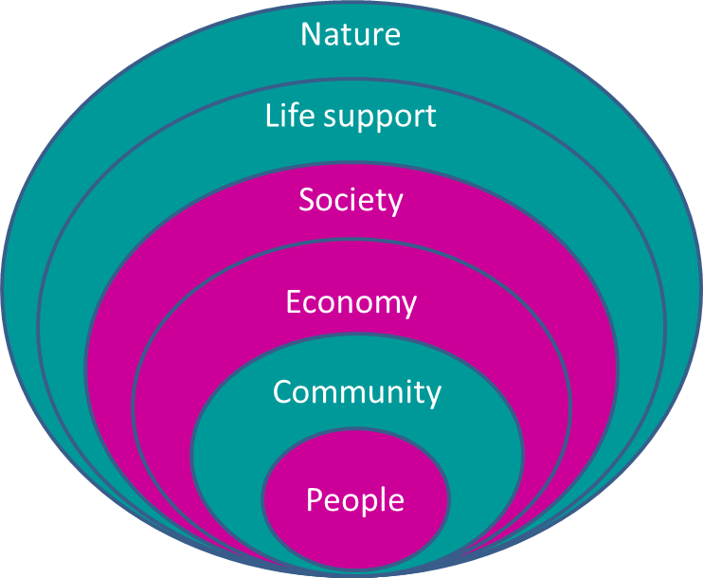
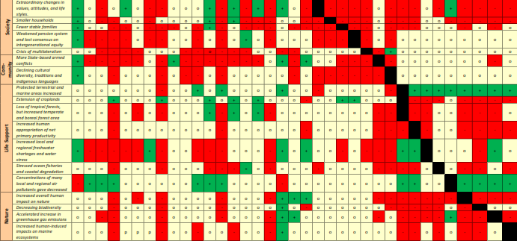
Prototype Global Sustainable Development Report
(3) Review of progress
    Lessons for future reports:
    → IA needed to monitor inter-linkages between issues; traditional SDG progress monitoring report will not strengthen the science-policy interface;

Slide 6
Prototype Global Sustainable Development Report
(4) Visions, scenarios and future pathways
    Lessons for future reports:
    → global scale, 2050 time frame with milestones; UN platform and cooperation on SD scenarios and future pathways toward SDGs.

Slide 7
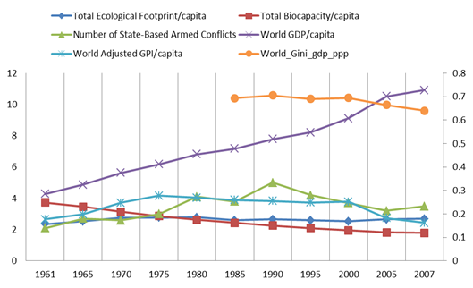
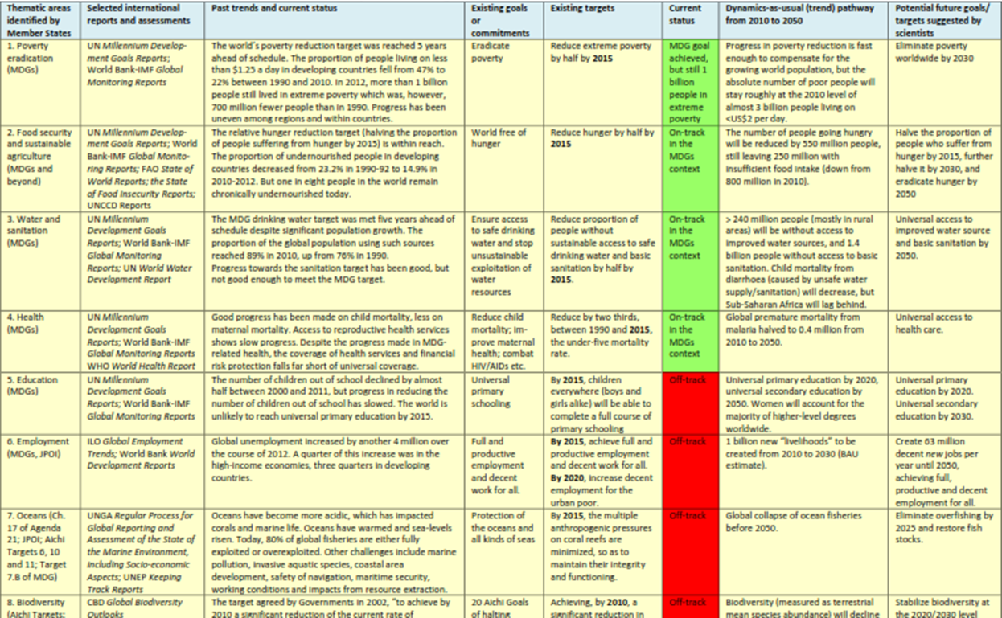
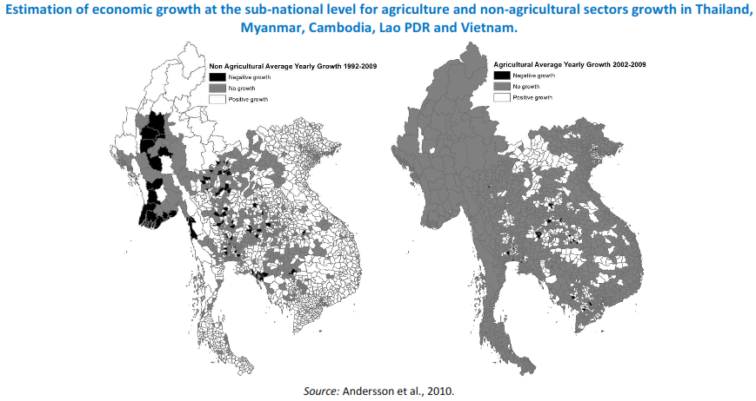
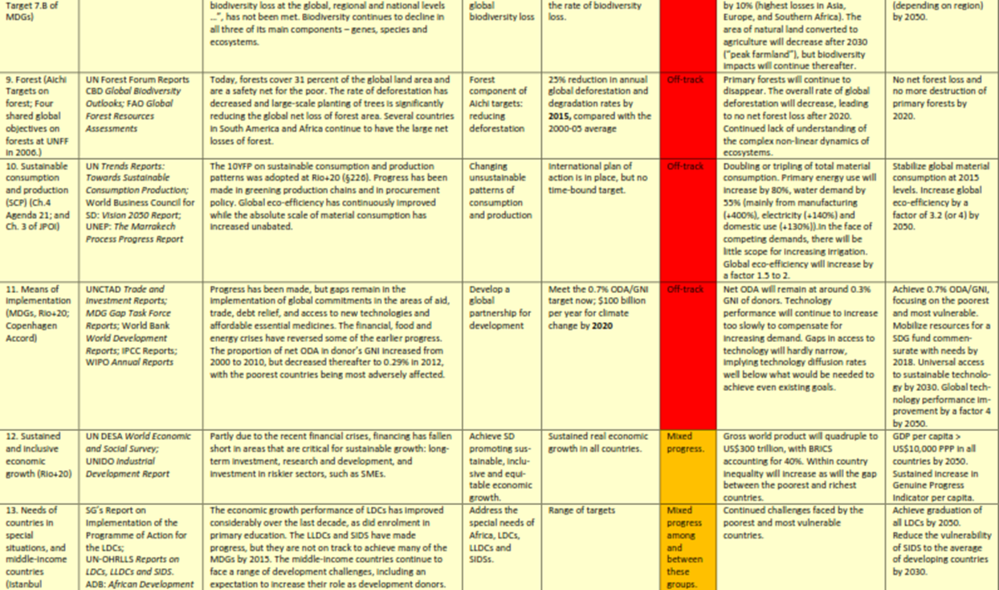
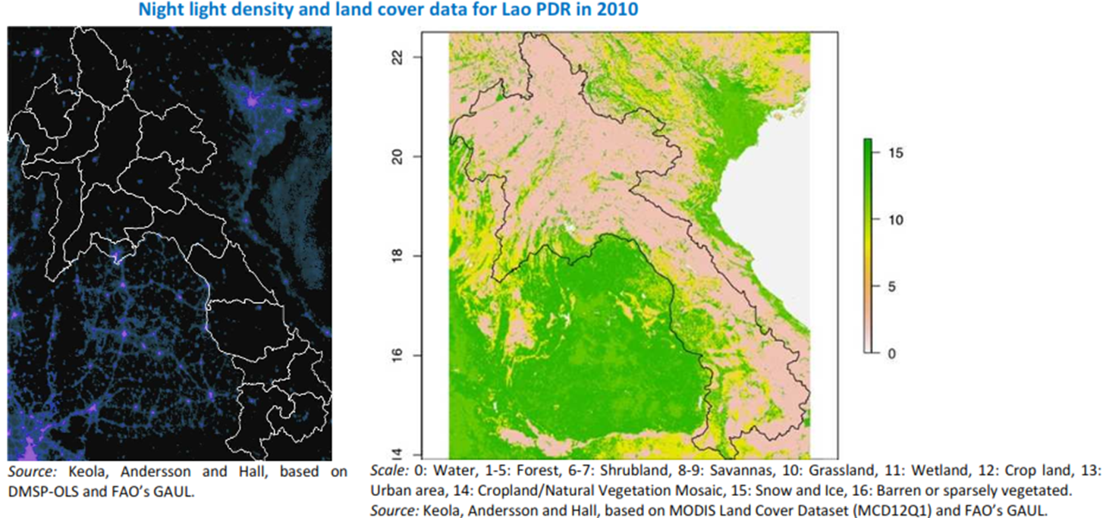
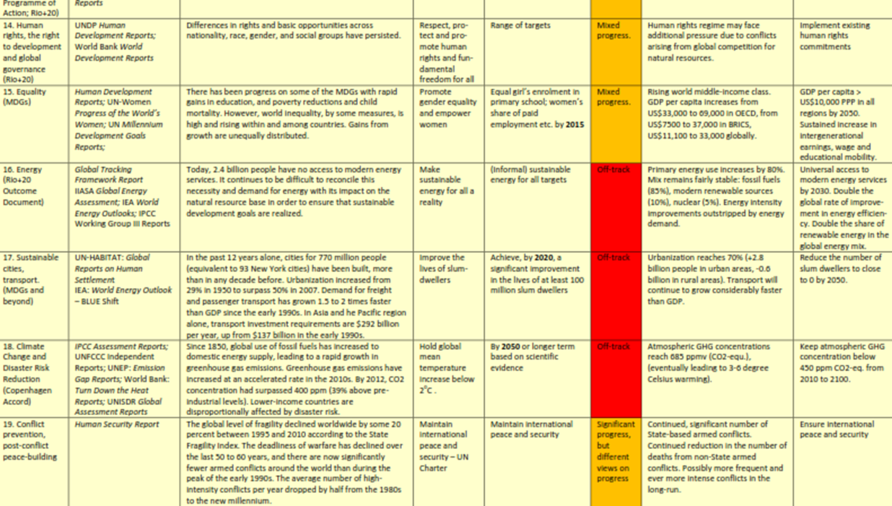
Prototype Global Sustainable Development Report
(5) Monitoring progress
    Lessons for future reports:
    → remote sensing and “big data” approaches for assessing long-term SD progress and fill data gaps in poorest regions

Slide 8
Prototype Global Sustainable Development Report
(4) Visions, scenarios and future pathways
    Lessons for future reports:
    → global scale, 2050 time frame with milestones; UN platform and cooperation on SD scenarios and future pathways toward SDGs.

Slide 9
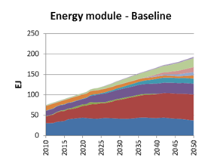
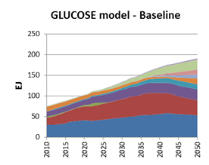
The Climate-land-energy-water-development (CLEWD) nexus
National and subnational case studies:
  Australia, Brazil, Burkina Faso, Canada, Cuba, Chile, China, Germany, India, Jamaica, Lithuania, Mauritius, Qatar, South Africa, Syria, Thailand, USA, UK, Tarawa/Kiribati, Comoros, Madagascar, Seychelles, Zanzibar, California.
Regional and international river basin case studies:
  Pacific, Indian Ocean, Africa, Europe and Central Asia, and the river basins of the Danube, Nile, and Mekong
  13 more proposed under UNECE water convention
Global climate-land-energy-water-development-materials nexus model

Slide 10
Hope you may want to get involved!
Thank you.

